Slide 1
Java vs. Python for Machine Learning
Keller Payne
CSCI 3090
Fall 2025

Slide 2
Machine Learning Background
Subset of artificial intelligence
  Algorithms that can learn patterns of training data ana make accurate inferences about new data
  Enables machine learning models to make decisions or predictions without hard-coded instructions.
Supervised vs. Unsupervised learning approaches

Slide 3
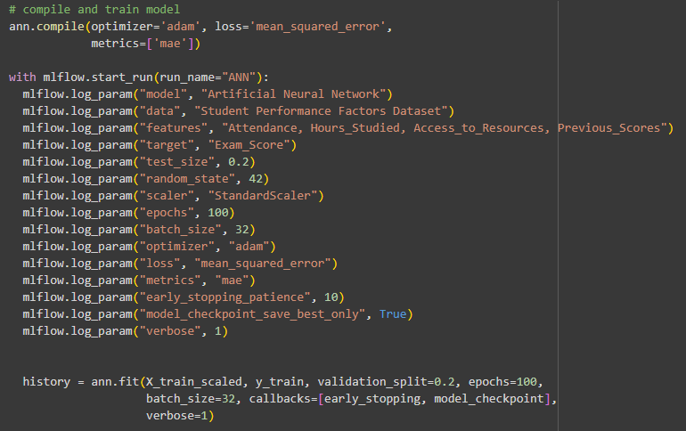
Why Python Dominates Machine Learning
Easy syntax and readability
Large ecosystem of libraries (NumPy, Pandas, Scikit-learn)
Strong community and support for AI research

Slide 4
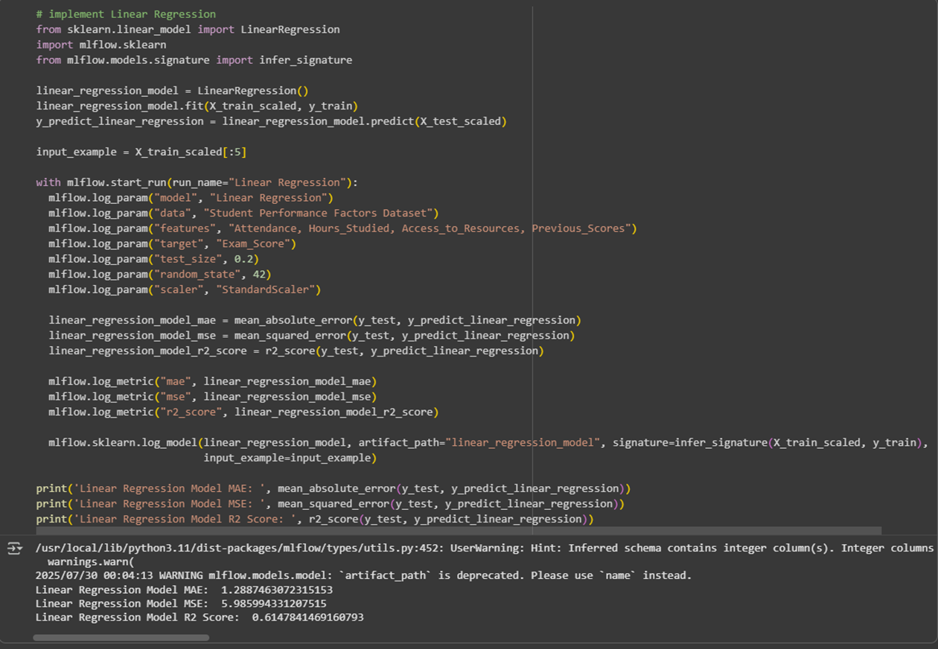

Slide 5
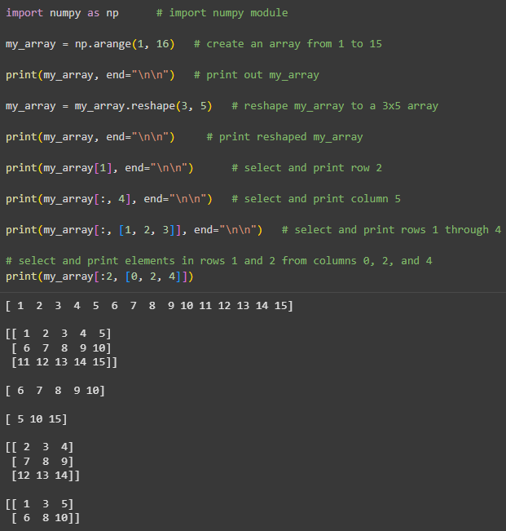
Python Libraries: NumPy
NumPy:
  efficient array processing and numerical computation
Simplifies complex operations with minimal code

Slide 6
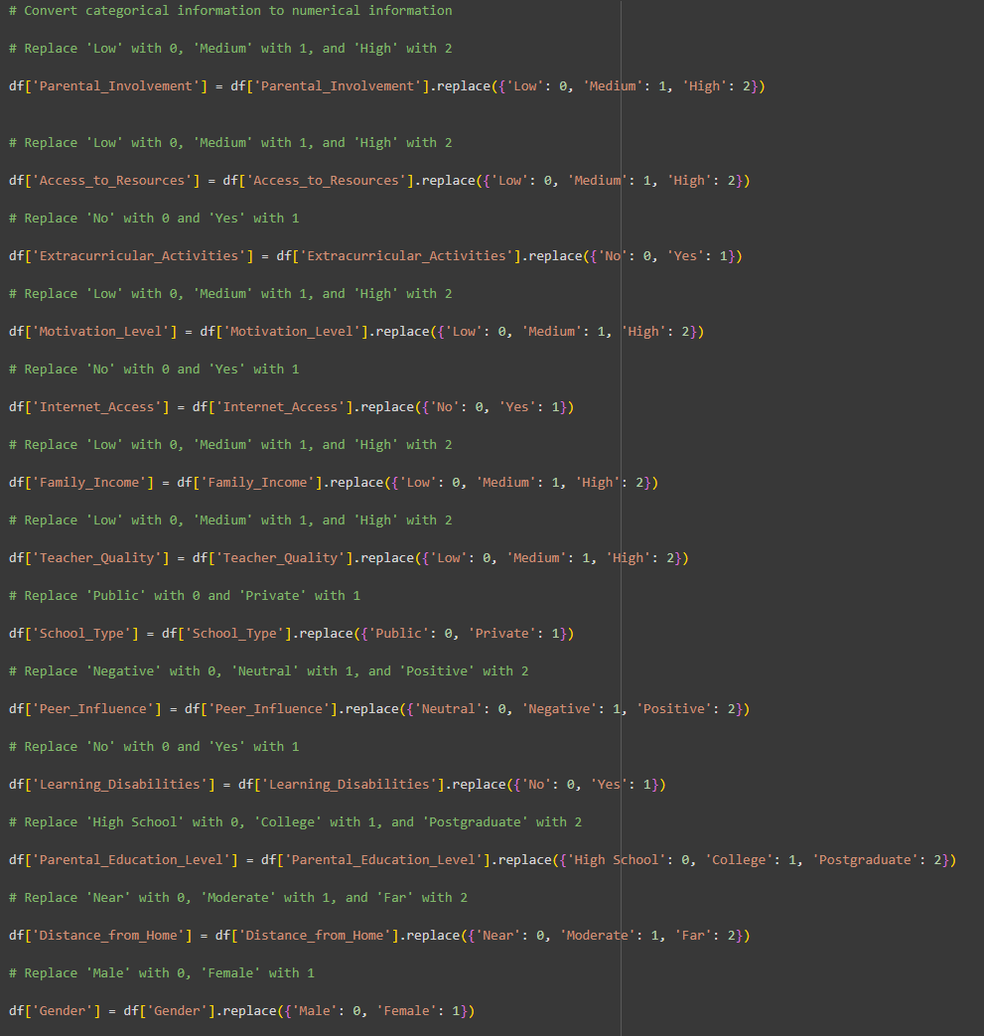
Python Libraries: Pandas
Pandas:
  data manipulation, analysis, and I/O support

Slide 7
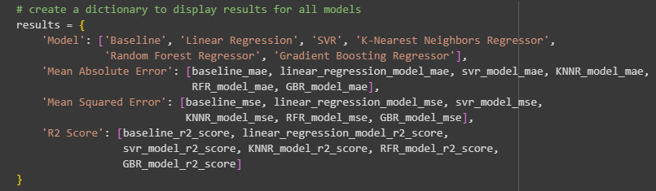
Python Libraries: Scikit-learn
Scikit-learn:
  traditional ML algorithms and model evaluation.
Well documented and widely used in research and production.

Slide 8
Java for Machine Learning
Often overlooked but has key strengths
Known for scalability, performance, and enterprise integration
Works well for production and big data applications

Slide 9
Java Library for Big Data: Apache Flink
Apache Flink:
  Real-time model inference
  Continuous model training
  End-to-End Machine Learning Pipelines
Java’s compiled nature boosts performance on large-scale data

Slide 10
Java Machine Learning Library: Tribuo
Tribuo
  modern, production-ready library created by Oracle
Emphasizes type safety, provenance tracking, and reproducibility

Slide 11
Comparing Java and Python for Machine Learning
Python | Java
Strengths: Rapid prototyping and experimentation Intuitive syntax ideal for beginners Active ecosystem with frequent updates Weaknesses: Slower Execution Dependency on Version Compatibility | Strengths: Faster Runtime Fewer Runtime errors Easier integration into preexisting software Weaknesses: Steeper Learning Curve Smaller Machine Learning Ecosystem
Choice depends on project scope and deployment needs
Both are working to bridge the gaps

Slide 12
Bridging the Gaps
Python:
  performance sensitive components implemented in optimized languages like C and C++
  REST APIs
  ONNX
Java:
  Libraries providing production-ready machine learning capabilities
  Actively expanding machine learning ecosystem
    LangChain4J

Slide 13
Wrap Up
Python remains dominant due to its ease of use and vast libraries.
Java is a strong contender for enterprise machine learning solutions.
Future machine learning systems may combine the strengths of both!

Slide 14
Sources:
“7 Best Java Machine Learning Libraries.” BairesDev, 15 May 2023, www.bairesdev.com/blog/best-java-machine-learning-libraries/.
aayan07. “Java for Big Data: All You Need To Know.” GeeksforGeeks. 23 July 2025. https://www.geeksforgeeks.org/blogs/java-for-big-data/#java-libraries-for-big-data.
Eker, Bayram. “Python vs. Java in AI (Late 2024): A Comprehensive Ecosystem Comparison with Scoring and Evaluation.” Medium. 7 Dec. 2024. bayramblog.medium.com/python-vs-java-in-ai-late-2024-a-comprehensive-ecosystem-comparison-with-scoring-and-evaluation-999a6896c4b0.
GeeksforGeeks. “Machine Learning with Java.” GeeksforGeeks, 4 Sept. 2024, http://www.geeksforgeeks.org/machine-learning/machine-learning-with-java/.
Ginsberg, Corey. “Pandas vs. NumPy: Which Python Library is Better for Data Analytics?” NobleDesktop. 15 July 2025. https://www.nobledesktop.com/classes-near-me/blog/pandas-vs-numpy-for-data-analytics.
Hernandez, Miguel. “Machine Learning In Java: From Concept to Code.” Parallelstaff.com, 2025, parallelstaff.com/implementing-machine-learning-in-java/.
“How AI and Machine Learning Is Transforming Computer Science - MyComputerCareer.” MyComputerCareer, 7 Oct. 2020, www.mycomputercareer.edu/how-ai-and-machine-learning-is-transforming-computer-science/.
Infuy. “Java Machine Learning and AI: A Guide to Building Intelligent Systems.” Medium, 12 June 2023, https://medium.com/@infuyIT/java-machine-learning-and-ai-a-guide-to-building-intelligent-systems-3d3e7e133a78.
Levy, Mike. “What is Scikit-learn and How Is it Used in AI?” Dataquest. 26 Apr. 2024. https://www.dataquest.io/blog/what-is-scikit-learn-and-how-is-it-used-in-ai/.
Niegowski, Tomasz. “Machine Learning in Java: Getting Started with Weka.” J-Labs. 9 Oct. 2024. https://www.j-labs.pl/en/tech-blog/machine-learning-in-java-getting-started-with-weka/.

